Slide 1

Types of Queue
Presented by:
Elizer Ponio Jr.
Department of Computer Science
College of Computing and Information Technologies

Slide 2
Outline
Circular Queue
Deque
Priority Queue
Notes:
Have you asked yourself the question, why do people organize?
Lets go to the psychology of organizing
This predictability applies within the context of our homes, manifesting through the concept of organization

Slide 3
What is a Circular Queue?
A circular queue is the extended version of a regular queue where the last element is connected to the first element forming a circle-like structure.
Notes:
Have you asked yourself the question, why do people organize?
Lets go to the psychology of organizing
This predictability applies within the context of our homes, manifesting through the concept of organization

Slide 4
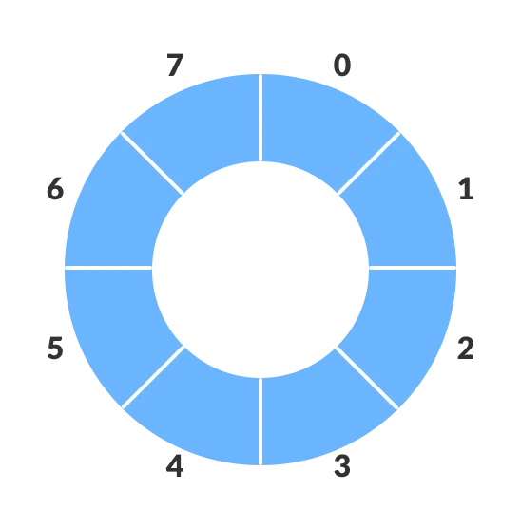
What is a Circular Queue?
Notes:
Have you asked yourself the question, why do people organize?
Lets go to the psychology of organizing
This predictability applies within the context of our homes, manifesting through the concept of organization

Slide 5
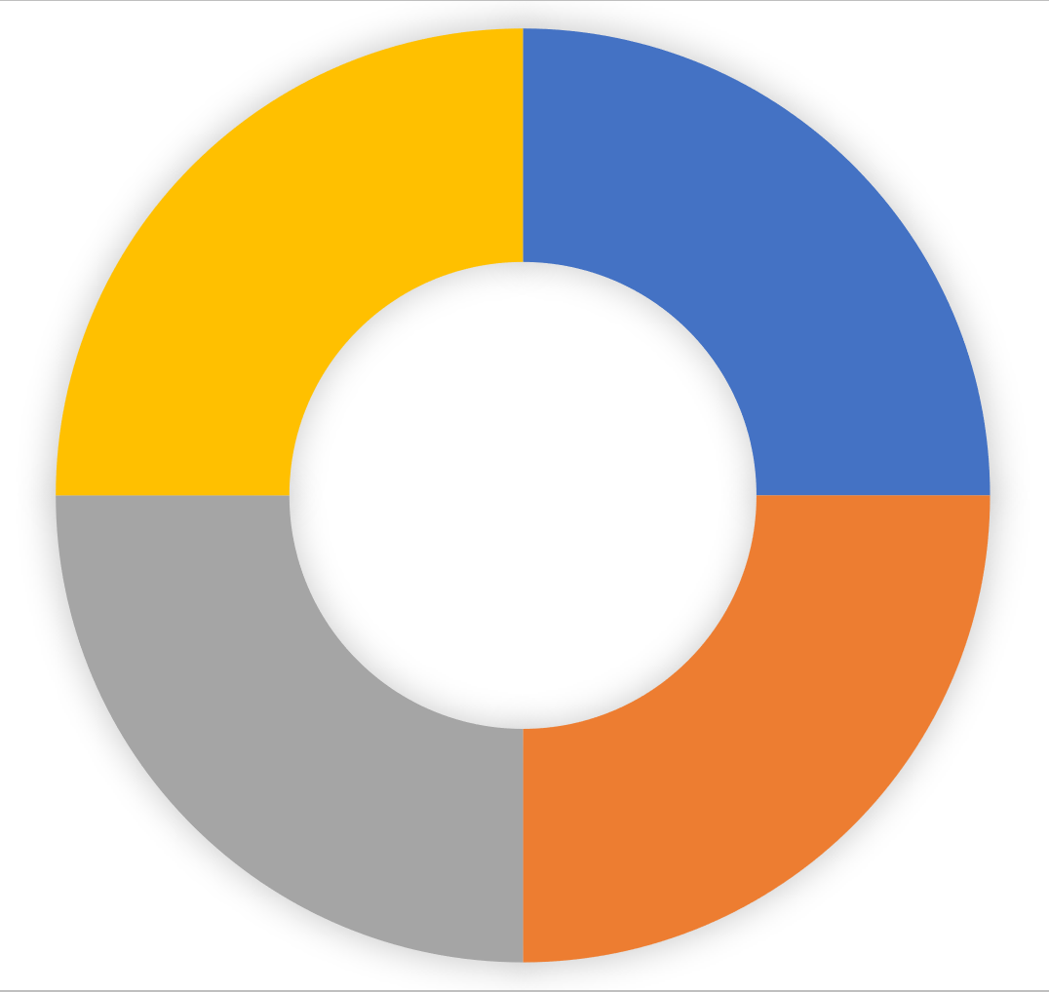
0 | 1 | 2 | 3
John
Jack
Jimmy
Jane
Front
Rear
Front
John
Jack
enqueue(“John”)
enqueue(“Jack”)
enqueue(“Jimmy”)
enqueue(“Jane”)
Jane
Jimmy
Rear
Notes:
Have you asked yourself the question, why do people organize?
Lets go to the psychology of organizing
This predictability applies within the context of our homes, manifesting through the concept of organization

Slide 6
0 | 1 | 2 | 3
John
Jack
Jimmy
Jane
Front
Front
Front
Rear
Front
Front
John
Jack
dequeue()
dequeue()
Jane
Jimmy
Rear
Front
Notes:
Have you asked yourself the question, why do people organize?
Lets go to the psychology of organizing
This predictability applies within the context of our homes, manifesting through the concept of organization

Slide 7
0 | 1 | 2 | 3
Elizer
Robert
Jimmy
Jane
Rear
Rear
Front
Rear
Rear
Rear
Elizer
Robert
enqueue(“Elizer”)
enqueue(“Robert”)
Jane
Jimmy
Front
Rear
Notes:
Have you asked yourself the question, why do people organize?
Lets go to the psychology of organizing
This predictability applies within the context of our homes, manifesting through the concept of organization

Slide 8

Circular Queue
Deque
Priority Queue
Notes:
Have you asked yourself the question, why do people organize?
Lets go to the psychology of organizing
This predictability applies within the context of our homes, manifesting through the concept of organization

Slide 9
What is a Deque?
Deque or Double Ended Queue is a type of queue in which insertion and removal of elements can either be performed from the front or the rear.
Notes:
Have you asked yourself the question, why do people organize?
Lets go to the psychology of organizing
This predictability applies within the context of our homes, manifesting through the concept of organization

Slide 10
John
Jack
Jimmy
Jane
Notes:
Have you asked yourself the question, why do people organize?
Lets go to the psychology of organizing
This predictability applies within the context of our homes, manifesting through the concept of organization

Slide 11
AddFront
Joe
John
Jack
Jimmy
Jane
Notes:
Have you asked yourself the question, why do people organize?
Lets go to the psychology of organizing
This predictability applies within the context of our homes, manifesting through the concept of organization

Slide 12
AddRear
Joe
John
Jack
Jimmy
Jane
Jill
Notes:
Have you asked yourself the question, why do people organize?
Lets go to the psychology of organizing
This predictability applies within the context of our homes, manifesting through the concept of organization

Slide 13
RemoveFront
Joe
John
Jack
Jimmy
Jane
Notes:
Have you asked yourself the question, why do people organize?
Lets go to the psychology of organizing
This predictability applies within the context of our homes, manifesting through the concept of organization

Slide 14
RemoveRear
John
Jack
Jimmy
Jane
Jill
Notes:
Have you asked yourself the question, why do people organize?
Lets go to the psychology of organizing
This predictability applies within the context of our homes, manifesting through the concept of organization

Slide 15
Circular Queue
Deque
Priority Queue
Notes:
Have you asked yourself the question, why do people organize?
Lets go to the psychology of organizing
This predictability applies within the context of our homes, manifesting through the concept of organization

Slide 16
What is a Priority Queue?
A priority queue is a special type of queue in which each element is associated with a priority value
Notes:
Have you asked yourself the question, why do people organize?
Lets go to the psychology of organizing
This predictability applies within the context of our homes, manifesting through the concept of organization

Slide 17
What is a Priority Queue?
Element | Priority Value
Jane | 3
Jack | 1
Jimmy | 2
John | 0
Lowest Priority
Highest Priority
Notes:
Have you asked yourself the question, why do people organize?
Lets go to the psychology of organizing
This predictability applies within the context of our homes, manifesting through the concept of organization

Slide 18
What is a Priority Queue?
Dequeue()
Element | Priority Value
Jane | 3
Jack | 1
Jimmy | 2
John | 0
Dequeue()
Jimmy
Jane
John
Jack
Jimmy
Jane
Jack
Jimmy
Jane
Jane
Notes:
Have you asked yourself the question, why do people organize?
Lets go to the psychology of organizing
This predictability applies within the context of our homes, manifesting through the concept of organization

